Slide 1
OBJECT DIMENSIONS FROM IMAGES
Shyama Bhuvanendran Sheela

Slide 2
TOPICS
Objective
How image is formed?
Implementation
Approach
Output
Results
Observations

Slide 3
OBJECTIVE
To determine the real dimensions of objects in a room using a virtual ruler.

Slide 4
HOW IMAGE IS FORMED?
World Points
Transformation
Perspective Projection
Scale Shift
Image Pixels

Slide 5
HOW IMAGE IS FORMED?
Transformation:
^{c}P = ^{c}R_{w} ^{w}P + ^{c}t_{w}
Extrinsic Matrix = [ ^{c}R_{w} | ^{c}t_{w} ]
Perspective Projection and Scale Shift:
^{im}x = -f * ^{c}X + O_{x}
s_{x} * ^{c}Z
^{im}y = -f * ^{c}Y + O_{y}
s_{y} * ^{c}Z

Slide 6
HOW IMAGE IS FORMED?
Intrinsic Matrix = [ -f/s_{x} 0 O_{x}
0 -f/s_{y} O_{y}
0 0 0 ]

Slide 7
IMPLEMENTATION
Reference Object Method
Uses an object of known dimensions in the image.
Stereo Method
Uses two images of the same scene captured from different positons in space.
The distance and orientation of camera at the two positions is known.

Slide 8
APPROACH – REFERENCE METHOD
Preprocess the image
Find Extrinsic Matrix
Compute Z
Compute other object dimensions

Slide 9
APPROACH – REFERENCE METHOD
Preprocess the image
Grayscale
Blur
Detect Edges

Slide 10
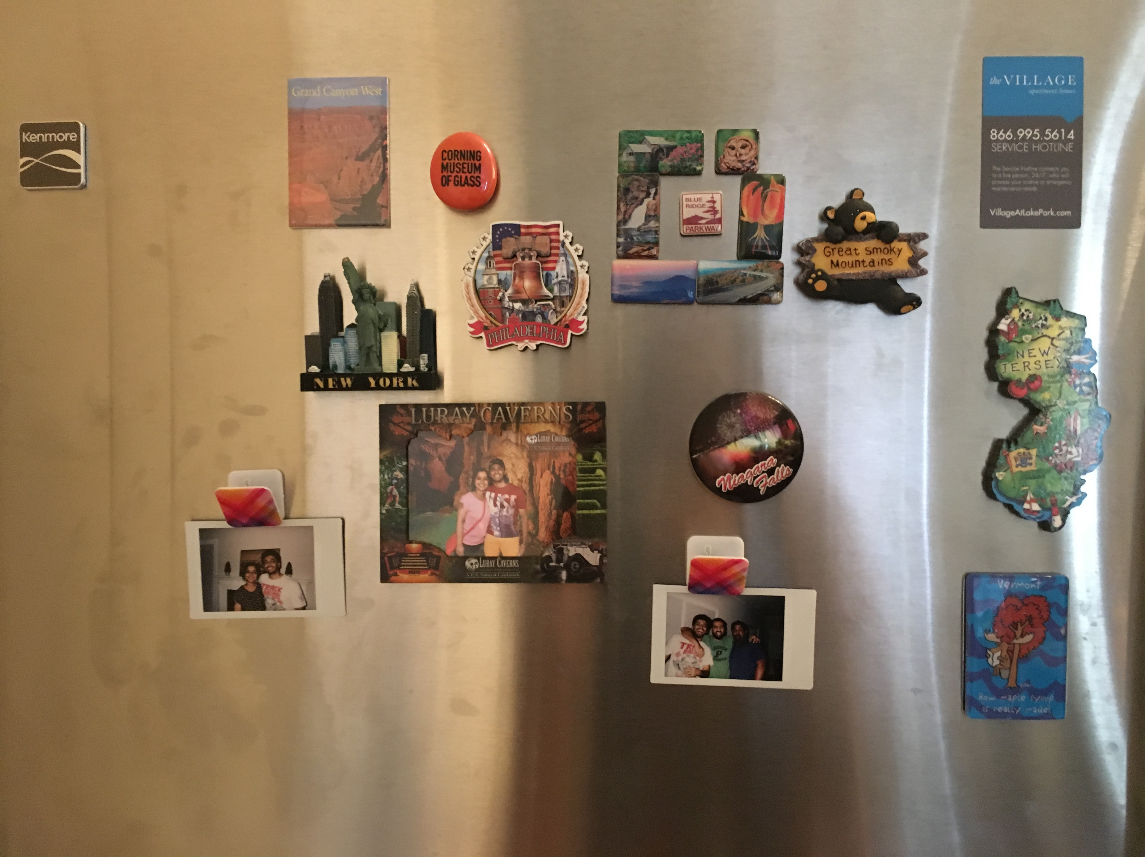
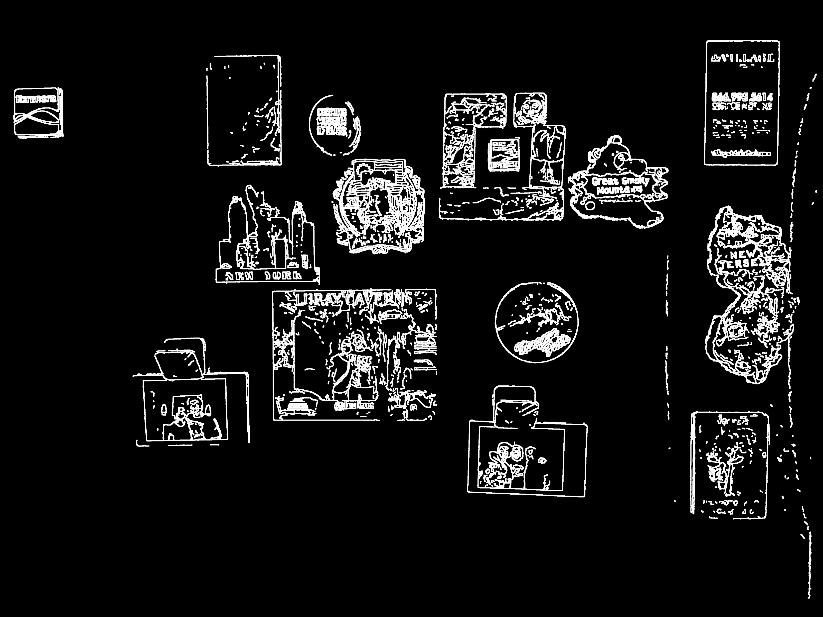
APPROACH – REFERENCE METHOD
Preprocess the image

Slide 11
APPROACH – REFERENCE METHOD
Preprocess the image
Find Contours
Bounding Rectangles

Slide 12
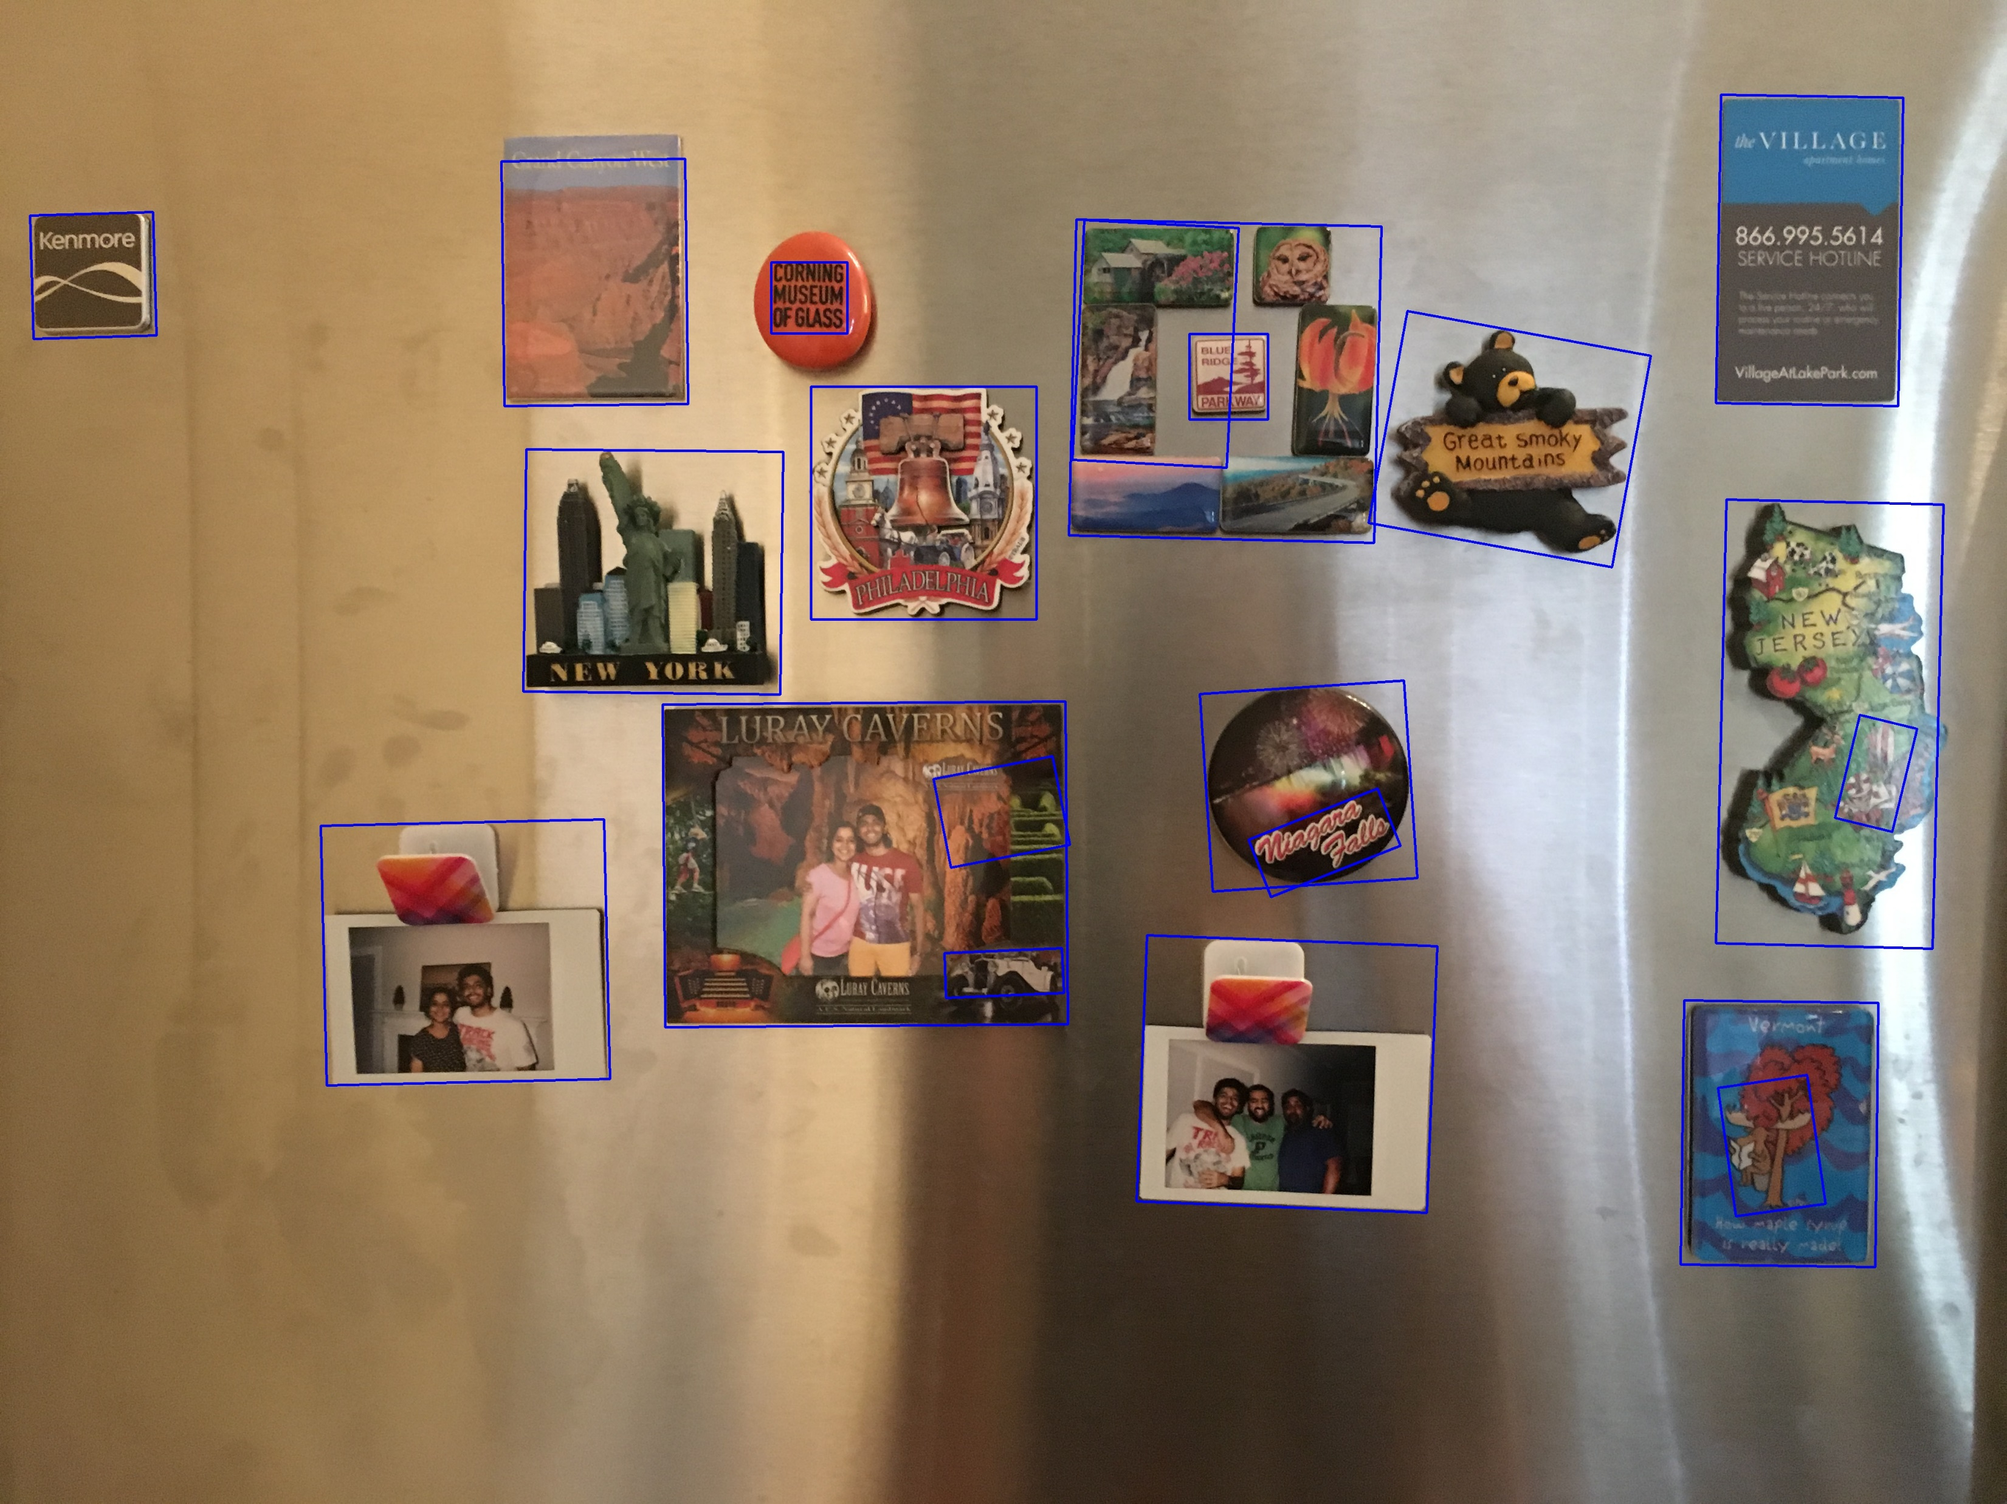
APPROACH – REFERENCE METHOD
Preprocess the image

Slide 13
APPROACH – REFERENCE METHOD
Find Extrinsic Matrix
Get the image coordinates of the reference object using its bounding rectangle.
Assume the reference object world coordinates using its known dimension.
E.g. vertex 1 – [ 0.0, 0.0, 0.0 ]
vertex 2 – [ 50.0, 0.0, 0.0 ]
vertex 3 – [ 50.0, 88.0, 0.0 ]
vertex 4 – [ 0.0, 88.0, 0.0 ]

Slide 14
APPROACH – REFERENCE METHOD
Find Extrinsic Matrix
Calculate tvec and rvec using solvePnp() method of Calib3d class.
tvec : [ -309.163922;
88.151640;
571.111726 ]
rvec : [ -0.032699;
3.166843;
0.053984 ]

Slide 15
APPROACH – REFERENCE METHOD
Find Extrinsic Matrix
Convert rvec to Rotation matrix using Rodrigues() method of Calib3d class.
Rotation : [ -0.999452, -0.021080, 0.025520;
-0.020198, 0.999206, 0.034341;
-0.026223, 0.033807, -0.999084 ]
Compute Extrinsic Matrix.

Slide 16
APPROACH – REFERENCE METHOD
Compute Z
Project the world coordinates of the reference object using Extrinsic Matrix.
Z is the same for all objects on the same plane as reference object.

Slide 17
APPROACH – REFERENCE METHOD
Compute other object dimensions.
Get the pixel coordinates of the minimum bounding rectangles.
Re-project to camera coordinate system using inverse intrinsic matrix.
Multiply by the computed Z.
Use distance formula to calculate dimensions.

Slide 18

OUTPUT – REFERENCE METHOD

Slide 19
APPROACH – STEREO METHOD
Preprocess the images.
Grayscale
Blur
Detect edges
Find Contours
Get vertices of the minimum bounding rectangles.

Slide 20
APPROACH – STEREO METHOD
Compute Z
Compute disparity of the two images using compute() method of StereoSGBM class.
Compute Z using the below formula:
Z = Focal-Length * Baseline-Distance
Disparity

Slide 21
APPROACH – STEREO METHOD
Compute camera coordinates.
Re-project the minimum bounding rectangle vertices of the objects to camera coordinate system using inverse intrinsic matrix.
Multiply the coordinates by the computed Z.
Calculate object dimensions.
Calculate object dimensions using distance formula.

Slide 22
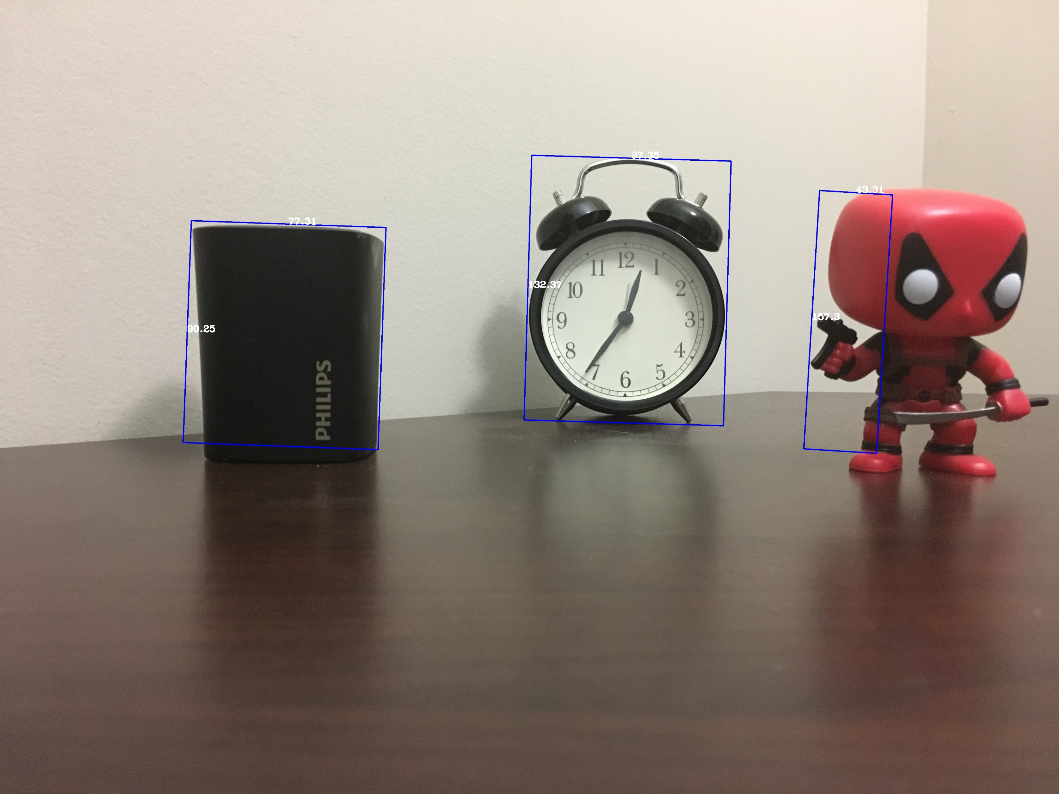
OUTPUT – REFERENCE METHOD
Average Accuracy = 77.20 %

Slide 23
RESULTS – REFERENCE METHOD
Index | Real Length | Calculated Length | Real Breadth | Calculated Breadth | Accuracy (%)
1 | 35 | 36.1 | 35 | 37.2 | 95.3
2 | 80 | 73.7 | 53 | 53.9 | 96
3 | 85 | 83.31 | 80 | 78.2 | 98
4 | 85 | 85.41 | 80 | 80.32 | 99.5
5 | 78 | 79.52 | 54 | 57.14 | 96.4
6 | 129 | 133.77 | 61 | 63.75 | 96
7 | 64 | 64.76 | 72 | 72.78 | 98.9
8 | 60 | 60.27 | 60 | 59.63 | 99.9

Slide 24
RESULTS – REFERENCE METHOD
Index | Real Length | Calculated Length | Real Breadth | Calculated Breadth | Accuracy (%)
9 | 67 | 66.45 | 70 | 70.28 | 99.8
10 | 71 | 73.03 | 72 | 75.56 | 96
11 | 24 | 23.13 | 24 | 25.78 | 98
12 | 90 | 89.77 | 93 | 95.25 | 99
Average Accuracy = 97.73 %

Slide 25
RESULTS – REFERENCE METHOD
Index | Real Length | Calculated Length | Real Breadth | Calculated Breadth | Accuracy (%)
1 | 68 | 77.31 | 82 | 90.25 | 88.3
2 | 95 | 157.3 | - | - | 35
3 | 200 | 153.1 | 140 | 127.3 | 82.5
4 | 135 | 118.8 | 98 | 112.5 | 86.8
5 | 98 | 108 | 135 | 140.8 | 93.21
Average Accuracy = 77.20 %

Slide 26
OBSERVATIONS
Reference Object Method:
Could determine dimensions with high accuracy for objects lying on the same X-Y plane as the reference object.
The accuracy dropped as the object distance from the reference object increases along the Z-axis.
Stereo Method:
Could determine the Z accurately.
The accuracy dropped in cases where the object detection method used couldn’t get the exact vertices of the objects in the image.

Slide 27
THANK YOU!

